Slide 1

Wisabi Bank ATM Transactions Report
Time Period from January to December 2022

Slide 2
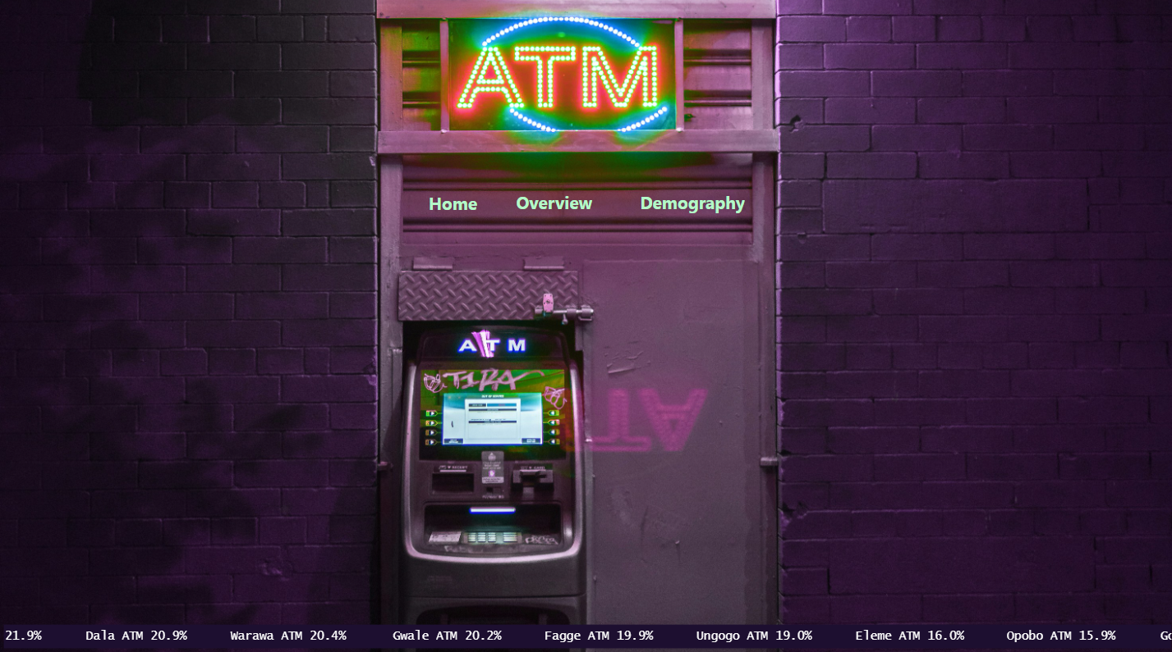


Slide 3
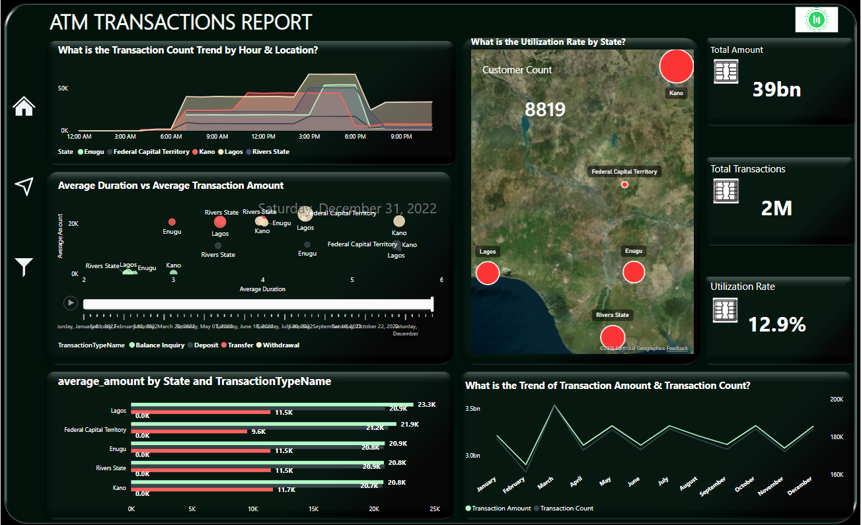

Slide 4
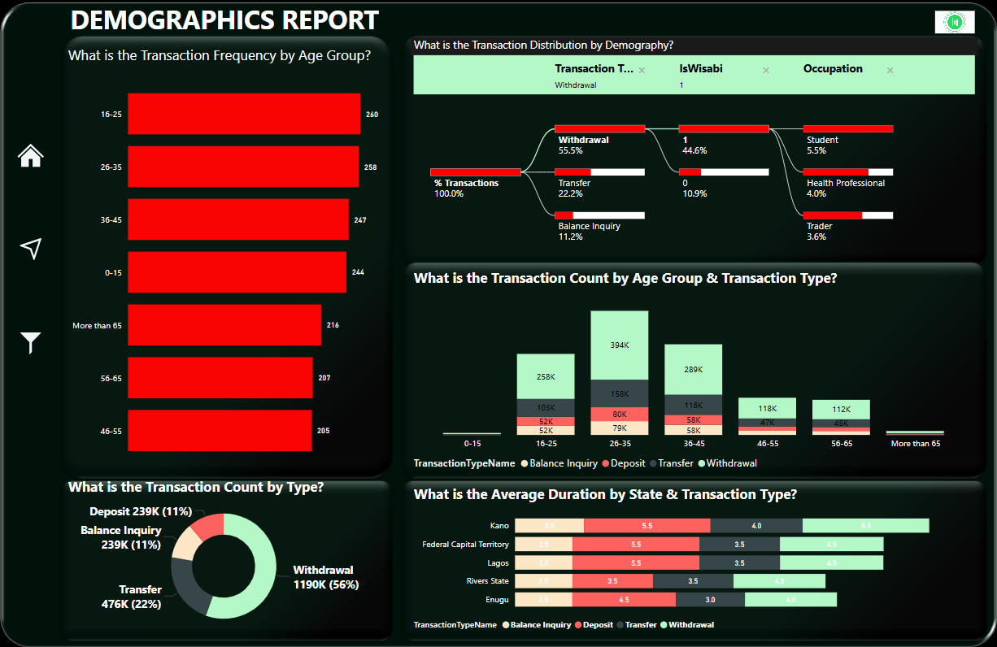

Slide 5
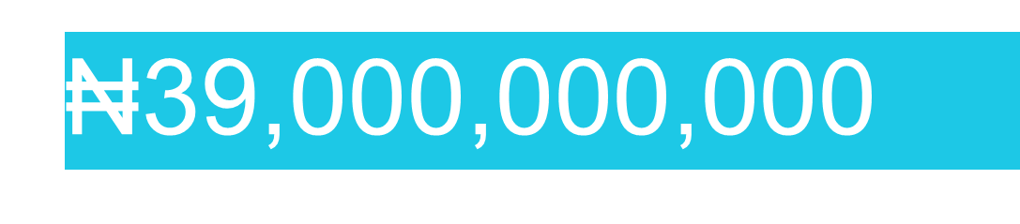
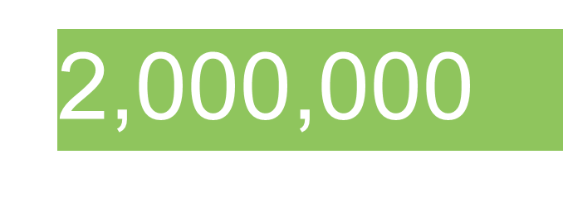

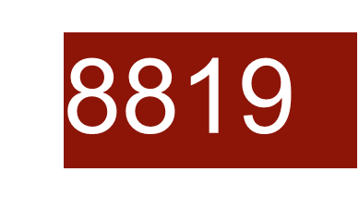
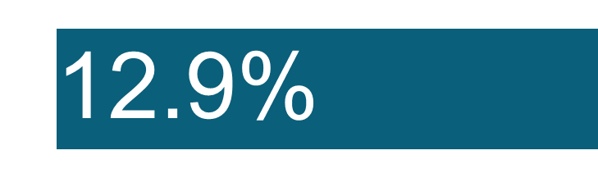

Slide 6
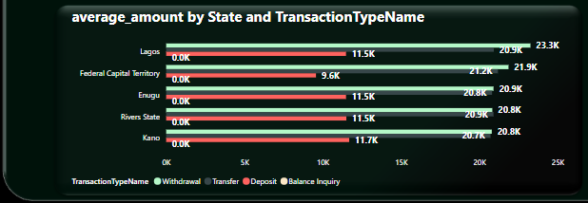
Average Amount by State and Transaction Type
Lagos is the leading state followed by Federal Capital Territory, then the least was Kano in terms of average amount transacted.
Withdrawal transaction is the highest form of transaction type followed by Transfer then Deposit then the least is Balance inquiry.

Slide 7
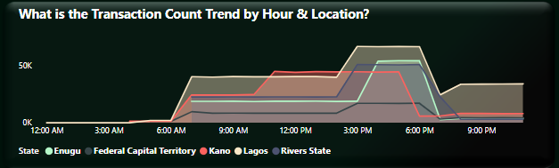
Daily ATM Transactions Trend
ATM transactions in Lagos increase from 6 AM, peaking between 3-7 PM.
Kano transactions peak earlier (around 11 AM) and decline after 5 PM.
Lagos has significant transaction activity after 7 PM compared to other states.

Slide 8
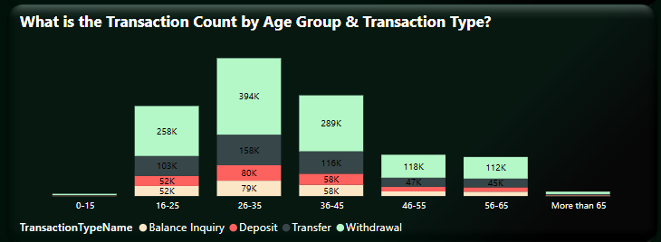
Age Group Transaction Count and Type of Transaction
Highest transactions occur in the 26-35 age group while the least is 0-15 age group.
Across all Age Groups, Withdrawals is the highest transaction type while Balance inquiry is the least transaction type.
16-25 and 36-45 age groups also show significant transaction volumes

Slide 9
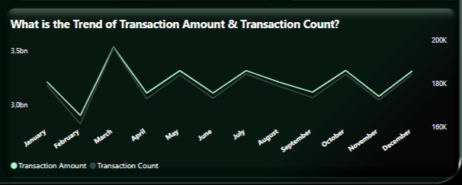
Trend of Transaction Amount over The Months
The month of March had the highest transaction amount and transaction count.
The month of February had the least transaction amount and transaction count.

Slide 10
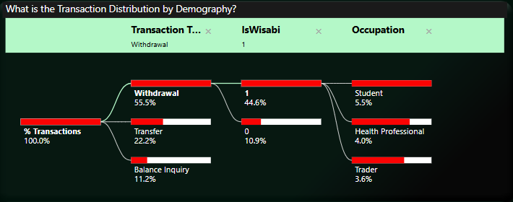
Common Transaction Type by Customer Type
Highest transaction type done is withdrawal while the least is Balance Inquiry.
Most transactions are done by Wisabi customers.
Highest withdrawals transactions are done by student, followed by health professional then the least is trader.

Slide 11
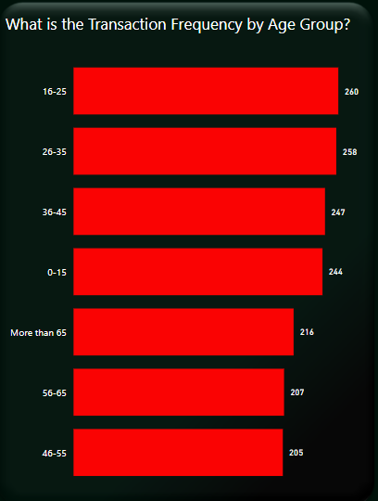
Transactions per Age Group
Customers in age group of 16-25 have the highest number of transactions.
Customers in the age group of 46-55 have the least number of transactions.
Customers in the age group of above 65 have a higher number of transactions than the age group of 56-65 and 46-55.

Slide 12
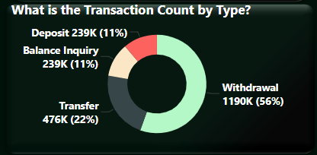
Transaction Count by Type
Withdrawal is the highest form of transaction type.
Deposit and Balance Inquiry are the least form of transaction type.

Slide 13
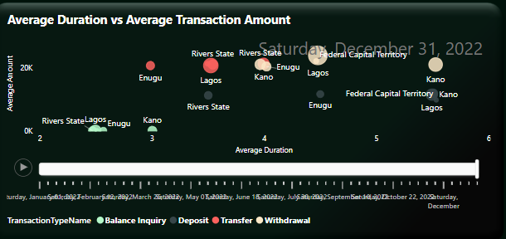
Average Amount vs Average Duration
On Average, while the transaction amount is comparatively similar, Withdrawals in Kano have the longest transaction duration (>5 mins) when compared with other states.
Kano, Lagos, and the FCT have longer transaction duration for Deposits (>5 mins) while Rivers has the lowest transaction duration for deposits.(<4 mins)
Kano also has the longest transaction duration for Balance Inquiries and Transfers.
Withdrawals have the highest transaction amount on average as expected. Withdrawals and Deposits have longer transaction duration on average while Balance Inquiries have the least transaction duration.

Slide 14
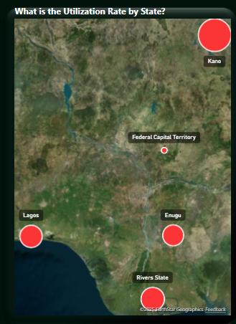
Utilization Rate by State
ATMs in Kano have the highest number of transactions rate of 18.6%.
ATMs in Rivers, Lagos and Enugu follow in terms of transaction rates of 12.7%,12.2% and 11.6% respectively.
The Federal Capital Territory has the least number of transactions rate of ATMs which is 8.5%.

Slide 15
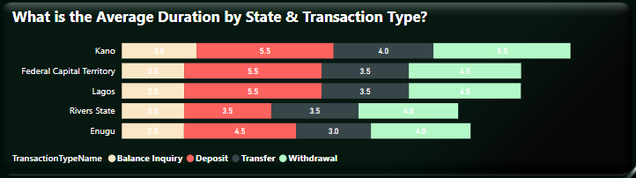
Average Transaction Duration
Across all locations, Deposits has the longest duration on average followed by withdrawals.
Kano’s average Withdrawal, Transfer, and Balance Inquiry durations are comparatively higher than other locations.
River State’s average Withdrawal, Transfer, and Balance Inquiry durations are comparatively least than other locations.
Rivers & Enugu have lower average transaction duration for Deposits, Transfers, & Withdrawals when compared to other locations.

Slide 16
Recommendations
Transaction Trends & User Behavior
Make ATMs More Available in Lagos & Kano: Lagos has many ATM users, especially after 7 PM, while Kano peaks around 11 AM. Wisabi Bank should ensure ATMs are working well during these times to avoid long queues.
Teach Customers About Mobile Banking: Many people use ATMs for withdrawals. Encouraging them to use mobile banking can make things easier and reduce ATM queues.
Expected Impact: Increased ATM usage in FCT and other low-utilization areas by at least 15% within six months.
2. ATM Utilization & Performance
Add More ATMs in Busy Areas: Kano has the highest ATM use (18.6%), followed by Rivers, Lagos, and Enugu. More ATMs in these areas will help avoid congestion.
Improve ATM Efficiency in Kano: ATMs in Kano take longer to complete transactions. Wisabi Bank should improve ATM speed and cash availability to serve customers faster.
Increase ATM Use in FCT: The Federal Capital Territory has the lowest ATM usage (8.5%). Wisabi Bank should improve ATM locations or inform people about them.
Expected Impact: A 30% reduction in average transaction time in Kano and other busy branches.

Slide 17
Recommendations
3. Understanding Customers
Offer Student-Friendly Banking: Young people (16-25 years) use ATMs the most, mainly for withdrawals. Wisabi Bank can introduce cheaper withdrawal fees or digital banking offers for students.
Improve Services for Older Customers: People above 65 use ATMs more than those aged 46-65. The bank should provide special services like easy-access ATMs or pension-friendly accounts.
Expected Impact: Higher satisfaction rates among students and older customers, leading to increased customer retention.
Transaction Efficiency & Experience
Reduce Transaction Durations in Kano: Since Kano has the longest transaction times (>5 minutes for withdrawals, transfers, and balance inquiries), Wisabi Bank should improve software, hardware, and cash refilling processes to speed things up.
Enhance ATM Infrastructure in High-Traffic Areas: Lagos, FCT, and Kano have long deposit durations (>5 minutes). Upgrading machines with faster processing times can improve customer experience.
Upgrade ATMs to Faster Models: Investing in modern ATMs with faster processing speeds will improve customer experience.
Expected Impact: A 30% reduction in average transaction time in Kano and other busy branches.

Slide 18
Recommendations
5. Promote Digital Banking & Reduce ATM Overload
Encourage Mobile & Internet Banking: Many ATM users only check balances or make transfers. Educating them on mobile banking will reduce ATM queues.
Give Incentives for Using Alternative Channels: Offer waived fees or small rewards for customers who use online or phone banking.
Ensure Phone Banking is Easy to Use: The process should be simple, with clear instructions and quick service.
Execution Plan: Launch an awareness campaign using SMS alerts, posters, and in-branch assistance to guide customers on using digital banking.
Expected Impact: A 25% reduction in non-cash transactions at ATMs within a year.
6. Optimize ATM Availability Based on Transaction Activity
Schedule Maintenance During Low Activity Hours: ATMs have reduced activity before 5 AM and after 8 PM, except in Lagos. Maintenance should be scheduled during these off-peak hours to minimize disruptions.
Ensure Maximum ATM Availability During Peak Hours: Each bank branch should ensure ATMs are fully functional and stocked during high-traffic periods to serve customers efficiently.
Expected Impact: Increased uptime of ATMs, reducing customer complaints by 40%.

